Slide 1
Techniques for Fault Detection and Visualization of Telemetry Dependence Relationships for Root Cause Fault Analysis in Complex Systems
Nathaniel Guy
(With support of Dr. Mehran Mesbahi and Dr. Jeffrey Heer)
Robotics, Aerospace, and Information Networks Lab
University of Washington - William E. Boeing Aeronautics and Astronautics
MSAA Thesis Presentation – March 16th, 2016

Slide 2
Overview
Motivation and Objectives
Model Definition
Fault Detection Background
Correlative Analysis and Visualization Background
Lunar Rover Ground Station Development
Intermediate Testing
2D Embedding Visualizations
Future Work and Conclusion
Acknowledgements
References

Slide 3
Overview
Motivation and Objectives
Model Definition
Fault Detection Background
Correlative Analysis and Visualization Background
Lunar Rover Ground Station Development
Intermediate Testing
2D Embedding Visualizations
Future Work and Conclusion
Acknowledgements
References

Slide 4
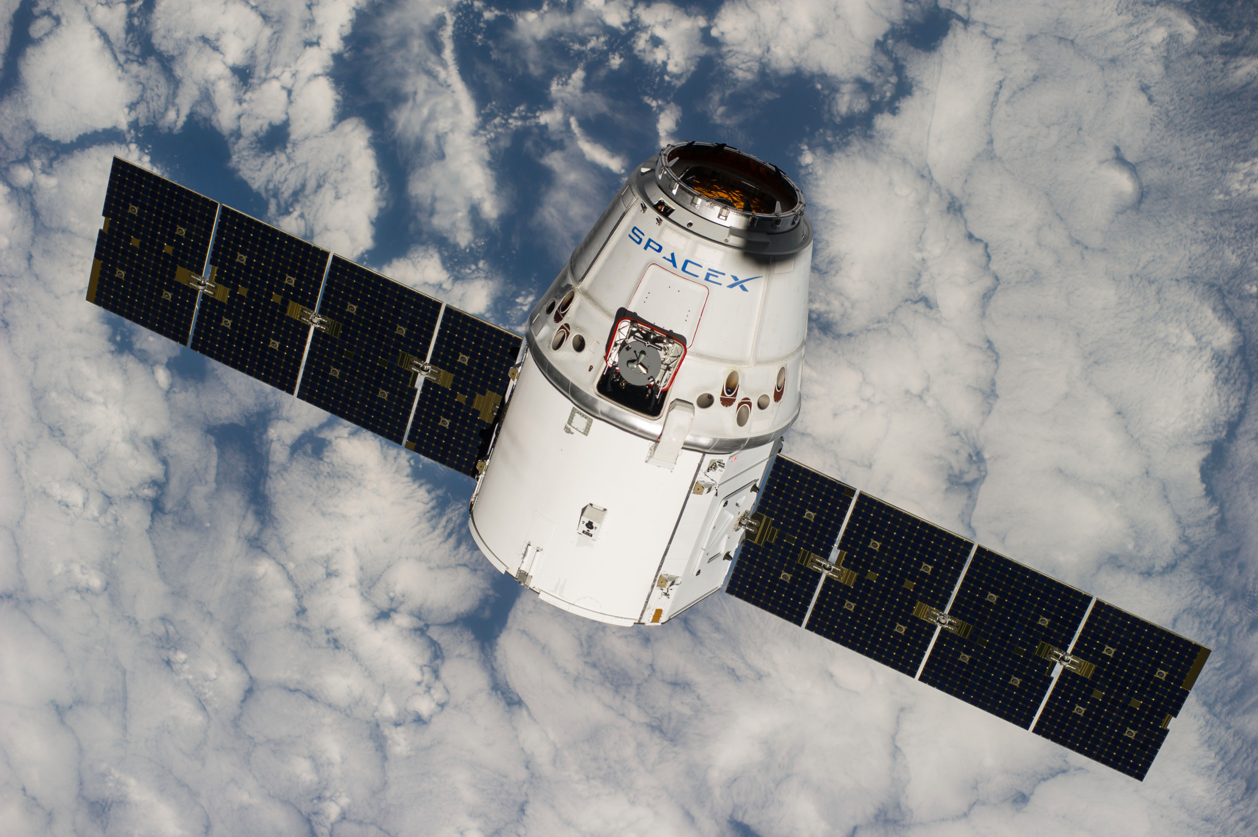
Complex, Remote-Operated Systems
Many types of systems must be teleoperated
Space systems
Underwater ROVs
Robots for radioactive environments
Difficult to troubleshoot
Large amounts of data
Data analysis and visualization becomes difficult
Vehicles such as the Dragon spacecraft have thousands of data channels!

Slide 5
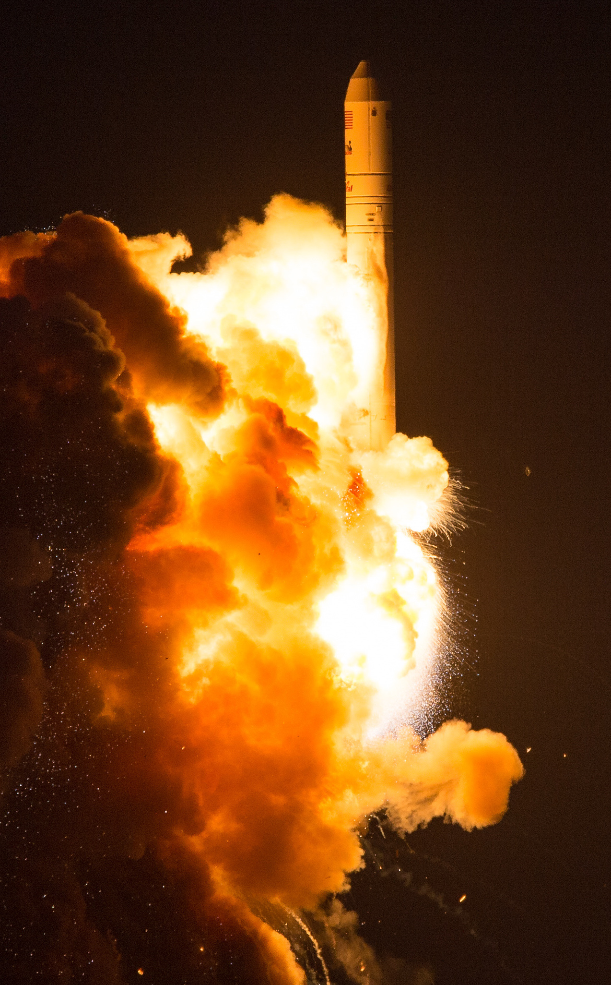
Antares CRS Orb-3
Orbital Sciences October 2014, ISS cargo delivery
Large explosion 6 seconds after launch
Catastrophic failure; cargo completely destroyed
What caused this?
Investigation immediately launched
Still no conclusive root case given; only vaguely linked to engine

Slide 6
Root Cause Analysis
Determining root cause for a problem very difficult
Problem detection often doesn’t capture cause
Very human-driven, but tools too simple
Many tools simply consist of plotting data channel time series
Need better tools for improving data review and linking detected problems to uncaptured causes

Slide 7
Objectives
Find analytical techniques that can improve root cause analysis
Make user-facing tools to improve human insight into system dynamics
Test above techniques on actual aerospace system data

Slide 8
Overview
Motivation and Objectives
Model Definition
Fault Detection Background
Correlative Analysis and Visualization Background
Lunar Rover Ground Station Development
Intermediate Testing
2D Embedding Visualizations
Future Work and Conclusion
Acknowledgements
References

Slide 9
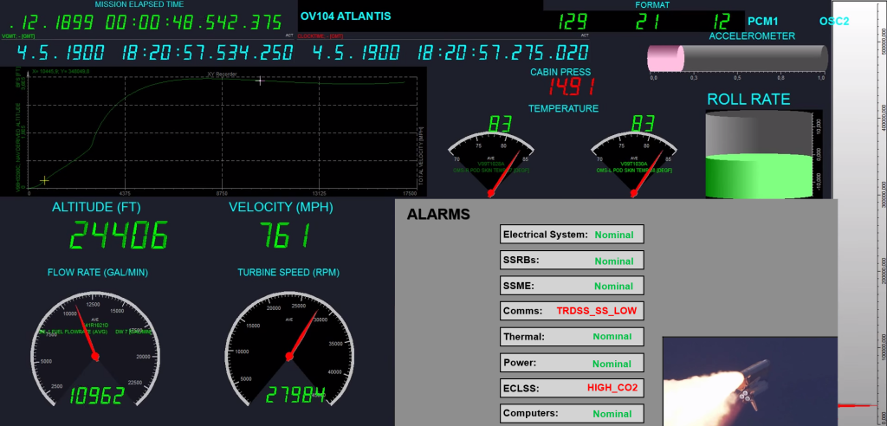
Data Sources
Data streams in discretely from a remote system
This data is “telemetry”
Combination of sensor readings and software metrics
Velocity, temperature, rotations, attitude, dropped packets, etc.
Higher-level telemetry: camera images, spectrograms, etc.
Often thousands of telemetry channels with frequent updates

Slide 10
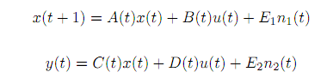
State-Space Model
State modeled discretely:
x(t): system state at time t
y(t): system measurement at time t
u(t): system input at time t
n₁(t) and n₂(t): system disturbance vectors at time t
A(t), B(t), C(t), D(t), E₁(t), E₂(t): linear dynamics
Telemetry data streams in, giving us values for y(t)
Individual elements of y(t) are called telemetry channels

Slide 11
Overview
Motivation and Objectives
Model Definition
Fault Detection Background
Correlative Analysis and Visualization Background
Lunar Rover Ground Station Development
Intermediate Testing
2D Embedding Visualizations
Future Work and Conclusion
Acknowledgements
References

Slide 12
Fault Detection, Isolation, and Recovery (Definitions)
A fault is any system state that is undesirable
FDIR is Fault…
Detection: deciding that a fault occurred
Isolation: determining where the fault occurred
Recovery: restoring the system to a non-faulted state
Normal/expected data is nominal
Otherwise, it’s anomalous
Faults can be divided into fault levels (by severity, or subsystem hierarchy)
Faults can trigger notifications to human operators, called alarms

Slide 13
Alarms

Slide 14
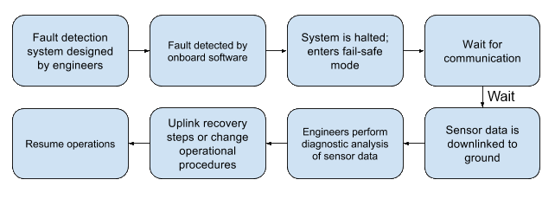
Fault Detection, Isolation, and Recovery (Process)
Many faults cannot be recovered from automatically
Complex issues require human intervention

Slide 15
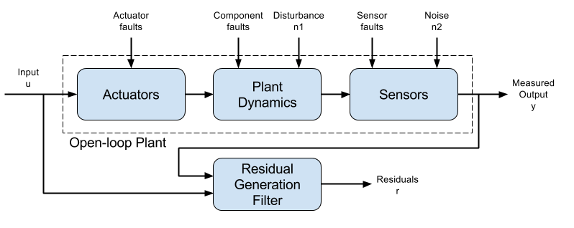
Residual Generation and Fault Detection
Measured output compared to expected system model to find difference
This “residual” used to detect faults
Often, residual simply is a deviation from the expected mean
If residual falls outside a given threshold, a fault may be triggered (e.g., “high acceleration”)

Slide 16
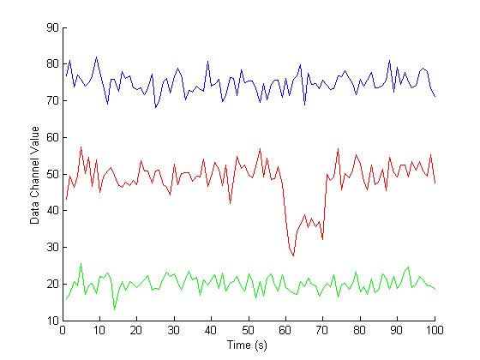
Threshold Fault Detection Example

Slide 17
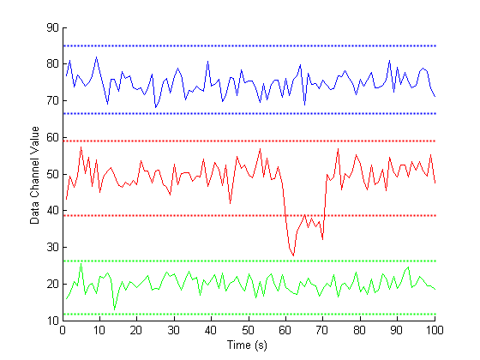
Threshold Fault Detection Example

Slide 18
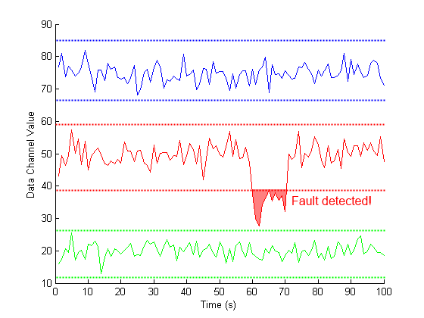
Threshold Fault Detection Example

Slide 19
Other Fault Detection Schemes
Many other types of fault detection
Combinations of complex rules
Probabilistic models
Machine learning from nominal and anomalous data
Redundant hardware systems
We’ll be focusing on models to find deeper root causes which can be agnostic to underlying FD system

Slide 20
Overview
Motivation and Objectives
Model Definition
Fault Detection Background
Correlative Analysis and Visualization Background
Lunar Rover Ground Station Development
Intermediate Testing
2D Embedding Visualizations
Future Work and Conclusion
Acknowledgements
References

Slide 21
Correlative Analysis: Motivation
Traditional FDIR only captures modeled faults
Channels contributing a fault residual may be “linked” to other channels
Or relationships at the time of a fault may be different from an earlier state, though raw telemetry is mostly nominal
Example: temperature and wheel rotation
Looking for correlations between channels may be able to find these links
Important to remember that correlation does not necessary imply causation, but can be suggestive

Slide 22

Correlative Analysis: Motivation
Traditional FDIR only captures modeled faults
Channels contributing a fault residual may be “linked” to other channels
Or relationships at the time of a fault may be different from an earlier state, though raw telemetry is mostly nominal
Example: temperature and wheel rotation
Looking for correlations between channels may be able to find these links
Important to remember that correlation does not necessary imply causation, but can be suggestive

Slide 23
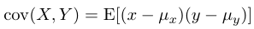
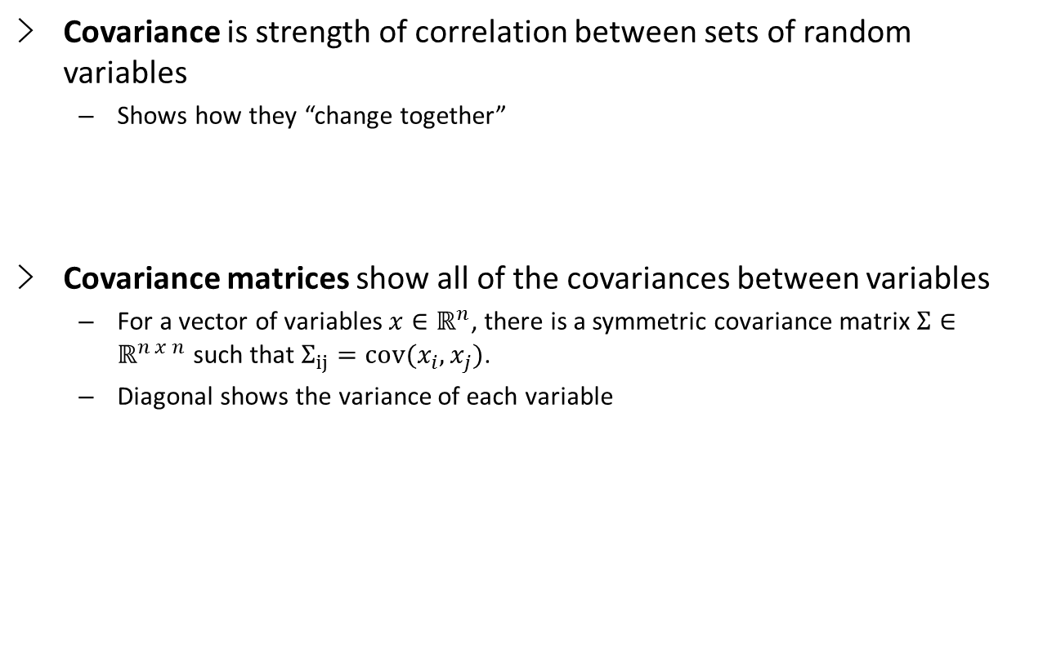
Covariance
Covariance is strength of correlation between sets of random variables
Shows how they “change together”
Covariance matrices show all of the covariances between variables
For a vector of variables $x∈ℝ^{n}$, there is a symmetric covariance matrix $Σ∈ℝ^{n x n}$ such that $Σ_{ij}=cov(x_{i},x_{j})$.
Diagonal shows the variance of each variable

Slide 24
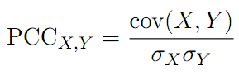
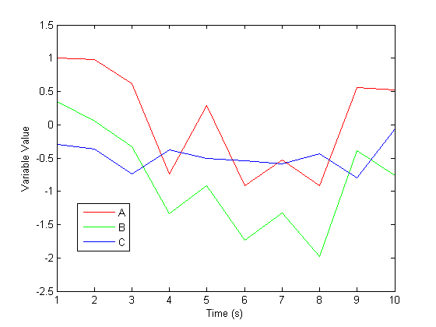
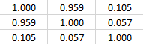
Correlation Metrics: PCC
We can scale a covariance matrix to get a normalized correlation between variables
Most common method is Pearson Correlation Coefficient (PCC):
PCC correlation “score” ranges from 1 (perfect positive correlation) to -1 (perfect negative correlation)
0 indicates no correlation
PCC Correlations
A
B
C
A
B
C

Slide 25
Correlation Metrics: PCC
PCC Correlations
A
B
C
A
B
C

Slide 26
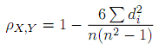
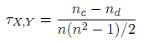
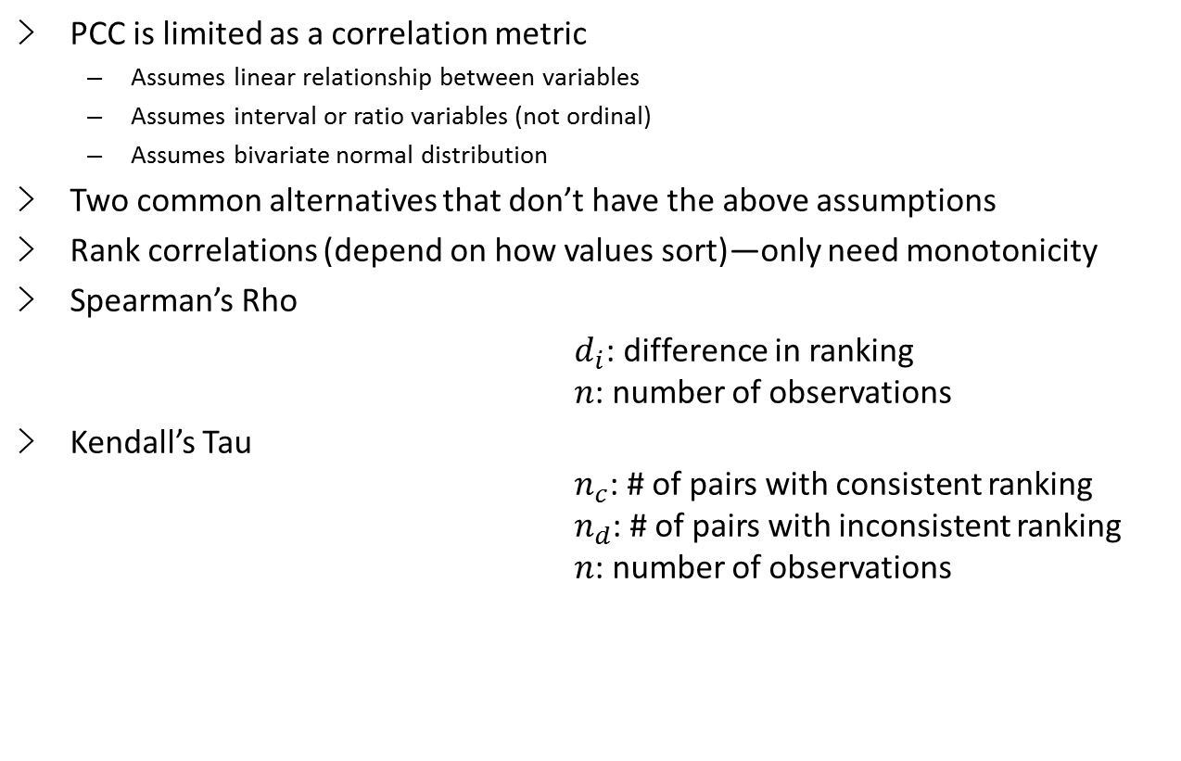
Correlation Metrics: Rho and Tau
PCC is limited as a correlation metric
Assumes linear relationship between variables
Assumes interval or ratio variables (not ordinal)
Assumes bivariate normal distribution
Two common alternatives that don’t have the above assumptions
Rank correlations (depend on how values sort)—only need monotonicity
Spearman’s Rho
$d_{i}$: difference in ranking $n$: number of observations
Kendall’s Tau $n_{c}$: # of pairs with consistent ranking $n_{d}$: # of pairs with inconsistent ranking $n$: number of observations

Slide 27
Static Corrgrams
Correlation matrices often shown as shaded grid (“corrgram”)
Each row is a variable; each column is a variable
Color of cell indicates correlation (usually dark for strong; light for weak)

Slide 28
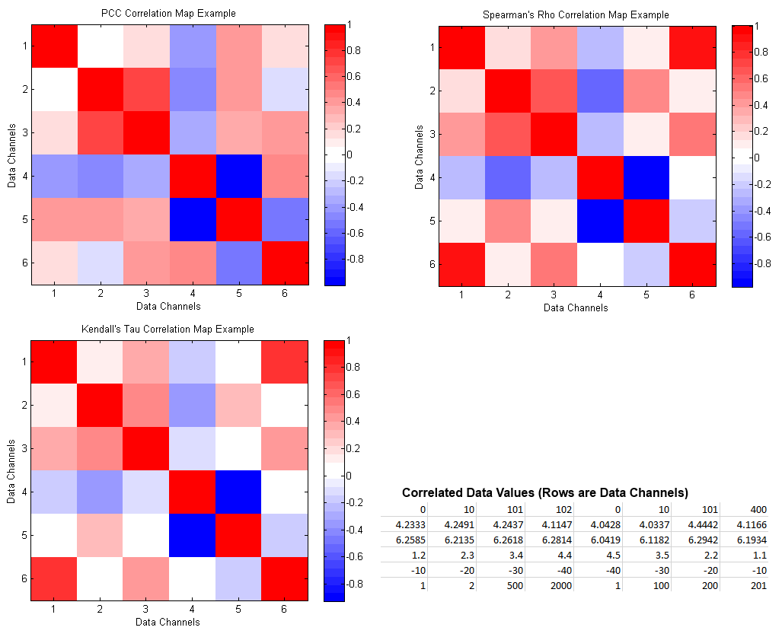
Correlation Metrics: Corrgram Comparison

Slide 29
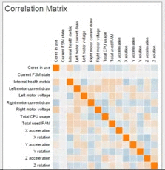

Animated Corrgrams
Corrgrams can only capture data at one point in time
If instantaneous correlation changes over time, we can capture this by sampling a time window
We can then update a corrgram with the latest correlations
Uncommon, but useful

Slide 30
Overview
Motivation and Objectives
Model Definition
Fault Detection Background
Correlative Analysis and Visualization Background
Lunar Rover Ground Station Development
Intermediate Testing
2D Embedding Visualizations
Future Work and Conclusion
Acknowledgements
References

Slide 31
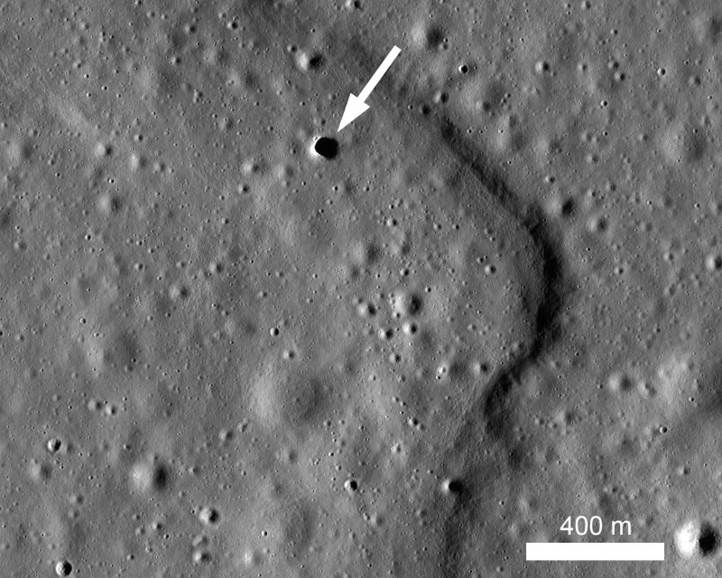

Hakuto and the Google Lunar XPRIZE
Google Lunar XPRIZE competition
Japanese team “Hakuto”
Based at Tohoku University, Sendai, Japan
Mission to the Moon in 2017
Complete GLXP requirements
Explore lunar caves

Slide 32
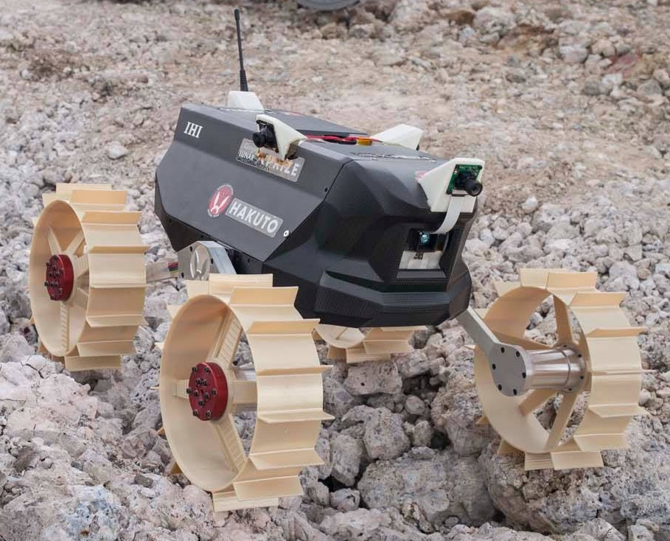
Moonraker Rover
Four-wheeled, 4kg micro-rover
In development since 2010
Four visible-spectrum cameras, 1 depth camera
Many other sensors
~112 telemetry channels

Slide 33
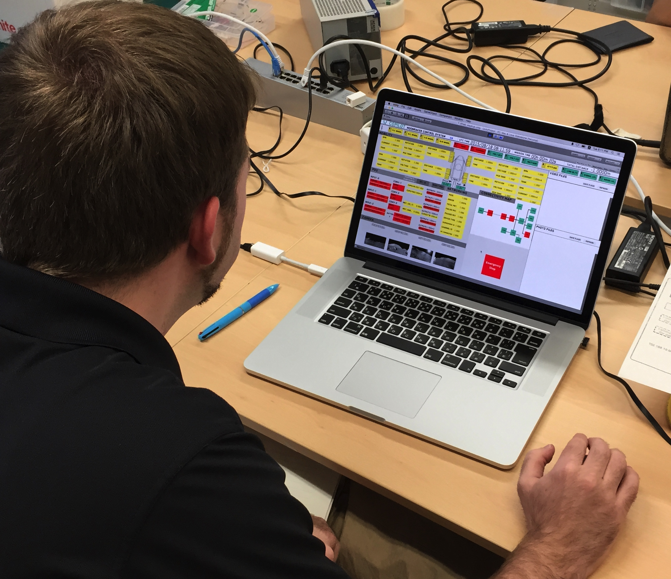
Ground Station Development
Interface for communicating with Moonraker
New system from scratch
Priorities
Easy to understand
Easy commanding
Robust to human error
Maintainable

Slide 34
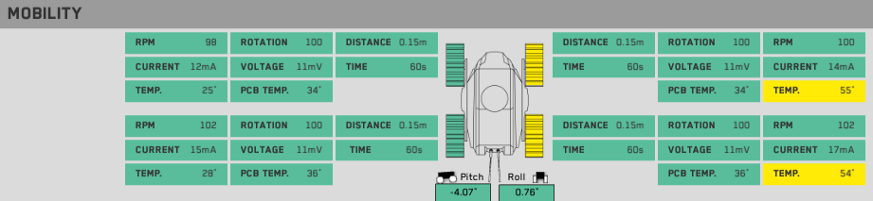
GSN Feature: Telemetry Display
Telemetry displayed on the screen when received
Telemetry grouped by subsystem

Slide 35
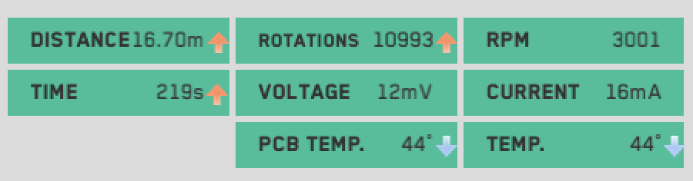
GSN Feature: Telemetry Change Indicators
Telemetry trends shown with arrow-based change indicator system

Slide 36
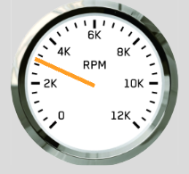
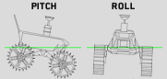
GSN Feature: Tachometer/Attitude Display
Pitch and roll
Calculated from accelerometer telemetry
RPM
Averaged from four-wheel motor telemetry

Slide 37
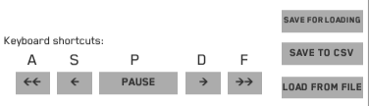
GSN Feature: Saving/Loading/Playback
Incoming telemetry can be paused
Can scrub back and forth through received data
Data can be saved/loaded, or exported to .csv format

Slide 38
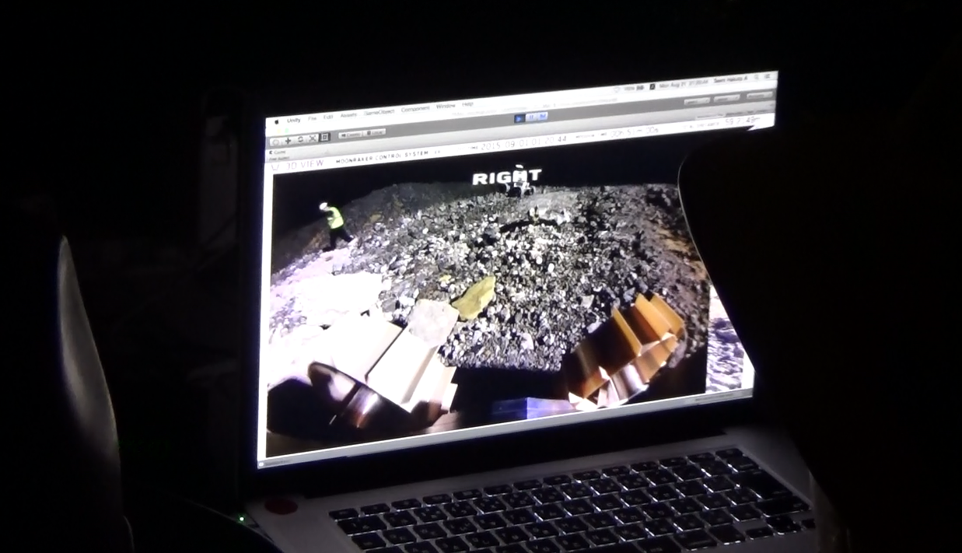
Immersive 3D View
User can rotate a camera inside a virtual 3D room
Each of the four “walls” shows a camera image
Gives intuitive understanding of environment

Slide 39
Threshold-Basic Fault Detection
Telemetry channels are grouped at the top of the screen
Telemetry values exceeding warning/danger thresholds are clearly shown on the screen

Slide 40
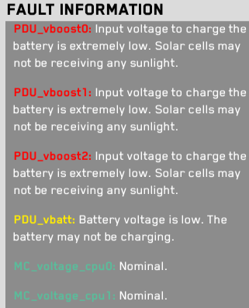
Detailed Fault Information
Fault-specified data shown for selected channels
Detailed descriptions can be provided
Allows for knowledge transfer from experienced operators

Slide 41
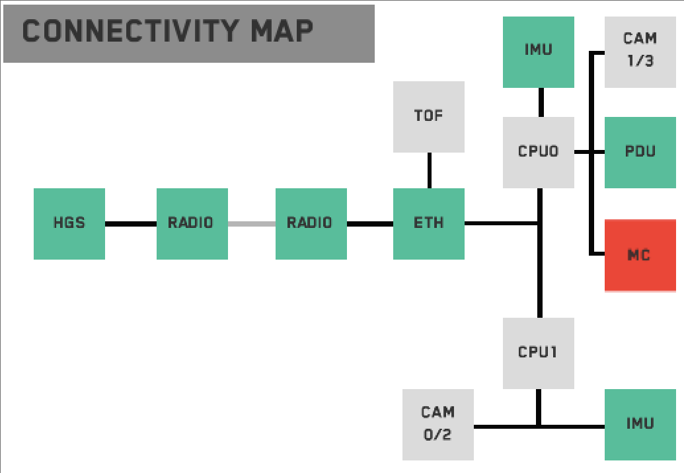
Connectivity Map
Visual display to show current status of modules
Modules change color to reflect how recently they’ve been heard from

Slide 42
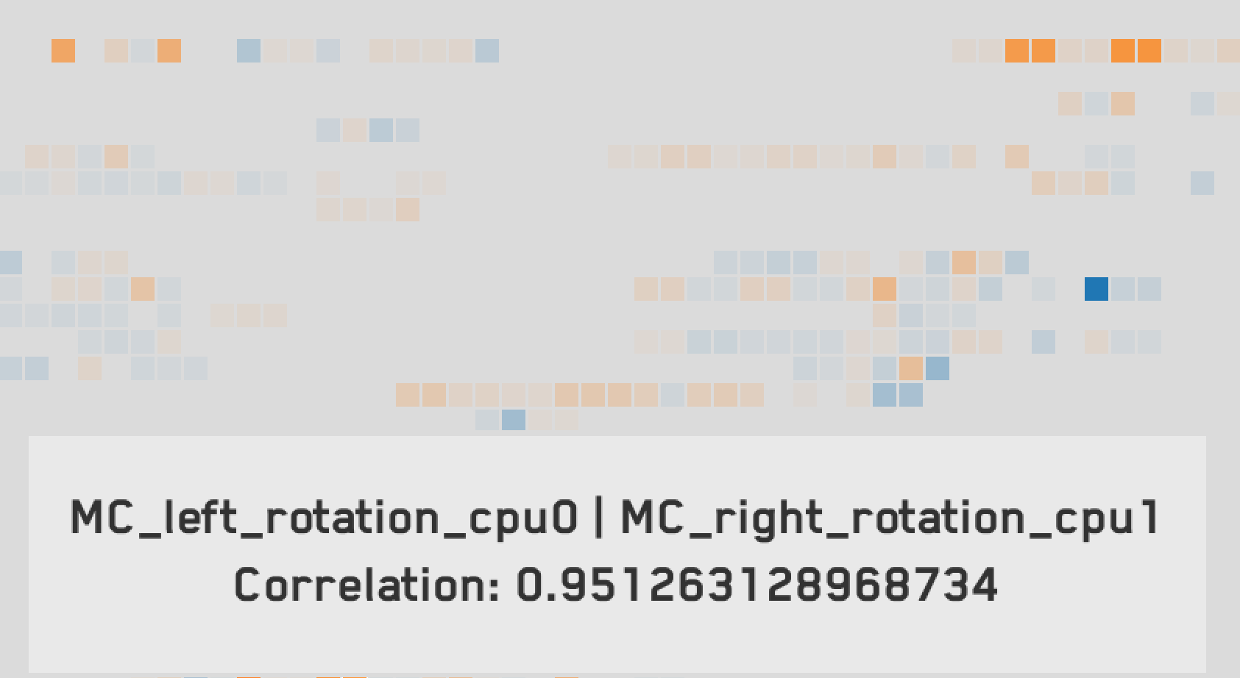
Animated Corrgram
2D grid of blocks
Each block shows the correlation between two channels
PCC correlation score shown as hue:
High positive correlation: orange
High negative correlation: blue
Grid updated with latest correlations

Slide 43
Animated Corrgram Screenshot

Slide 44
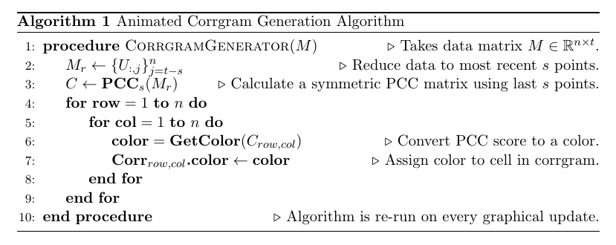
Animated Corrgram Implementation

Slide 45
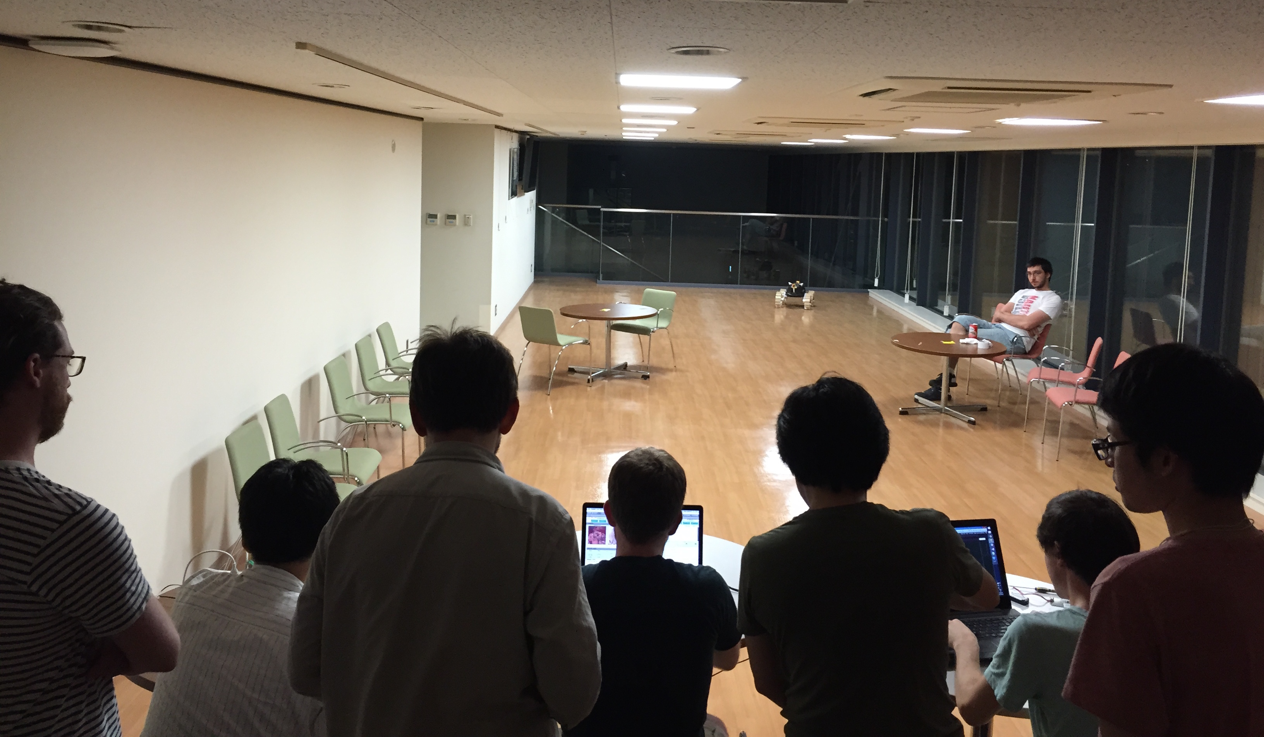
First Integration

Slide 46
Overview
Motivation and Objectives
Model Definition
Fault Detection Background
Correlative Analysis and Visualization Background
Lunar Rover Ground Station Development
Intermediate Testing
2D Embedding Visualizations
Future Work and Conclusion
Acknowledgements
References

Slide 47
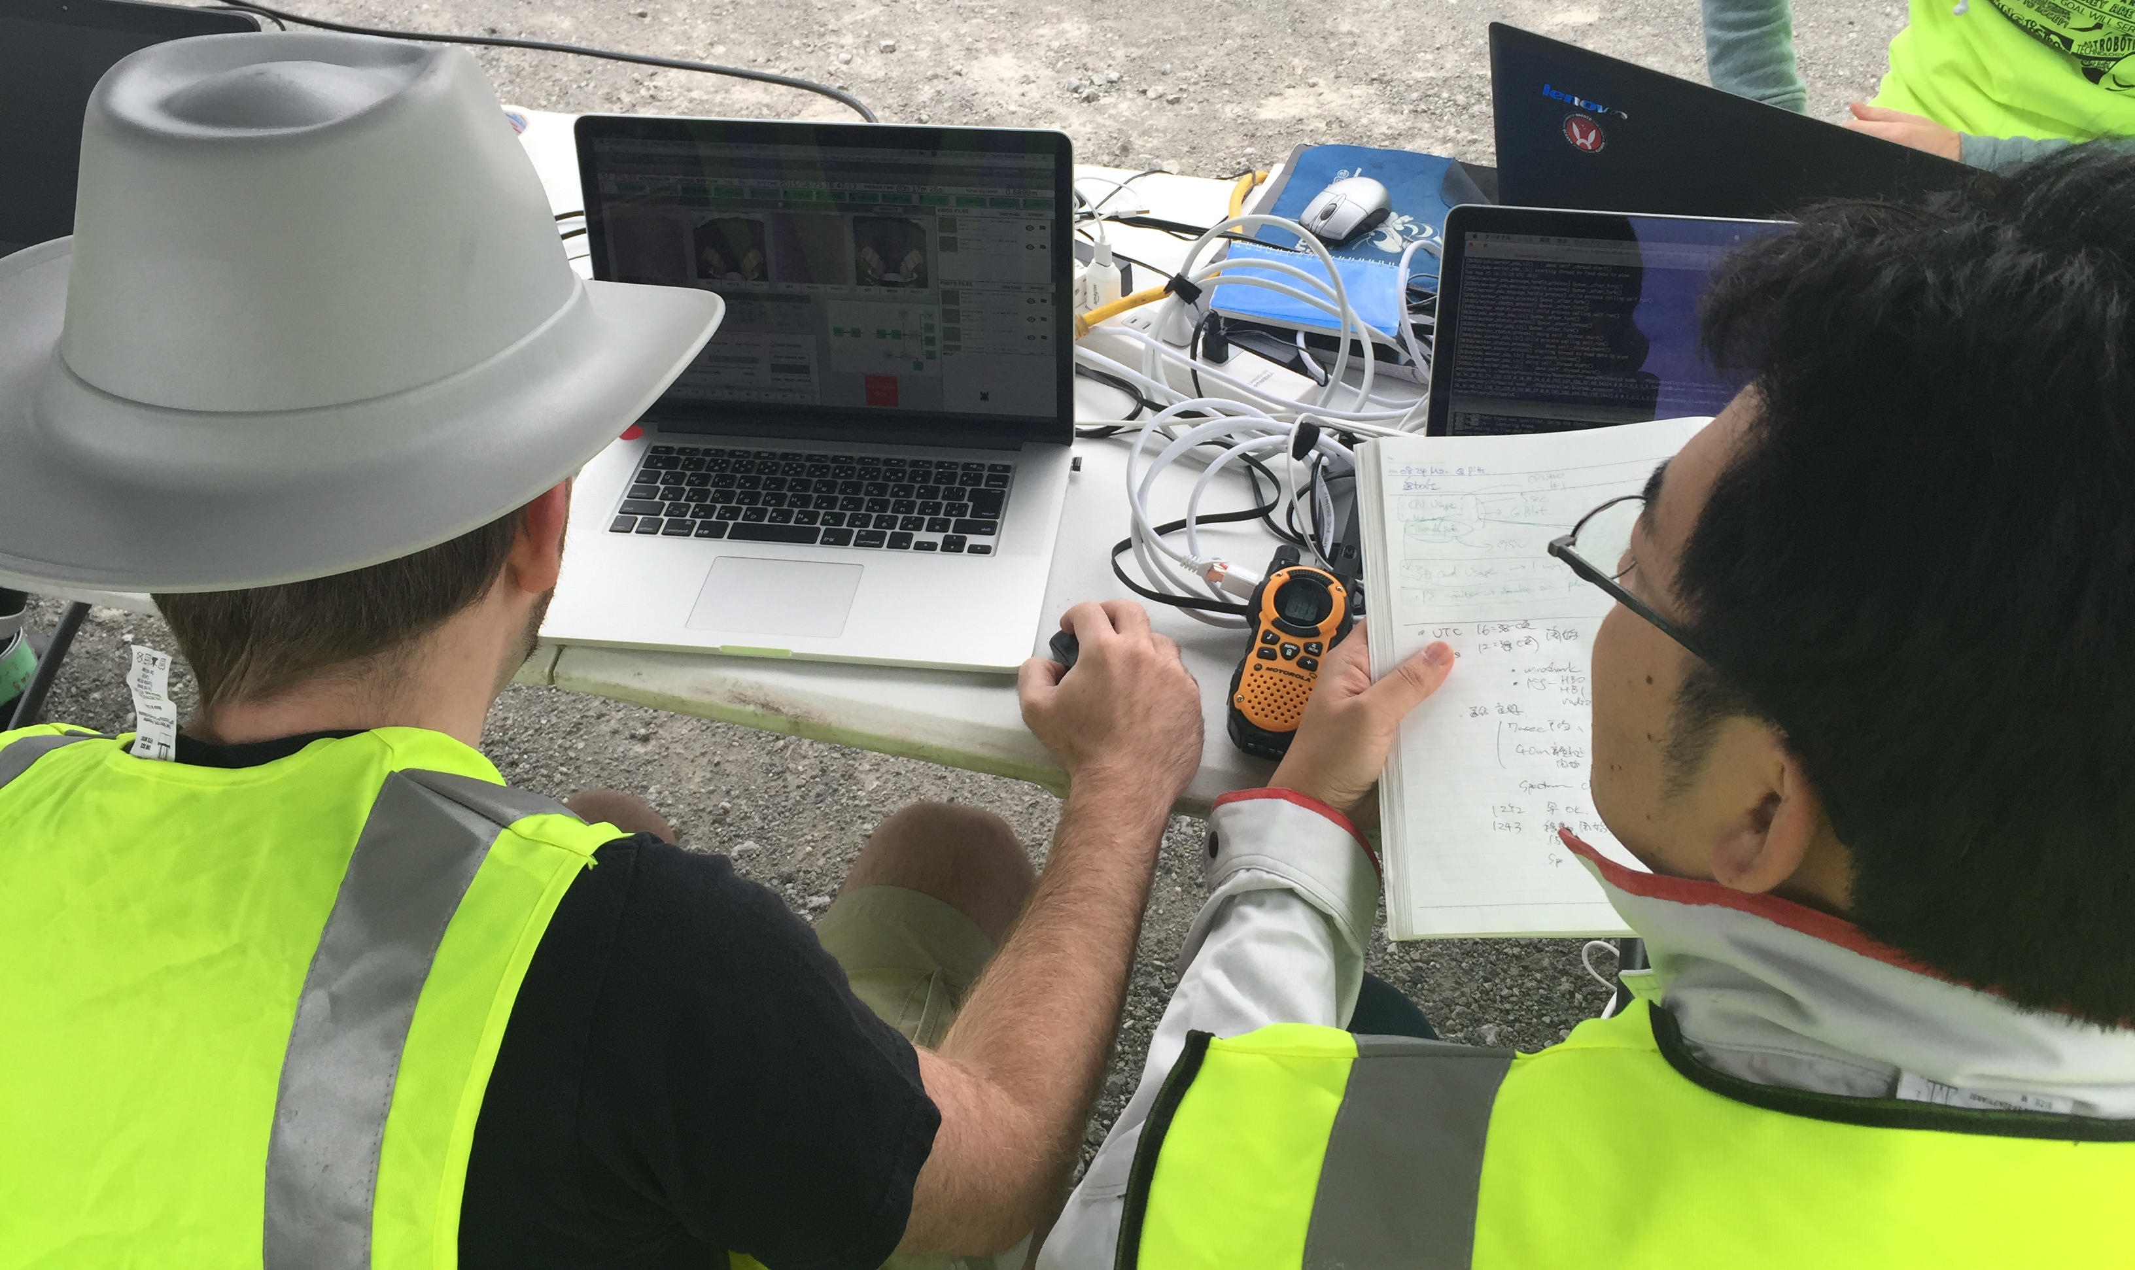
Pittsburgh Field Testing
Six Hakuto engineers went to Pittsburgh in August 2015
Tested rover systems on moon-like terrain (rock quarry)
Did tests in lunar lighting-like conditions
Controlled Moonraker from my ground station for all tests

Slide 48
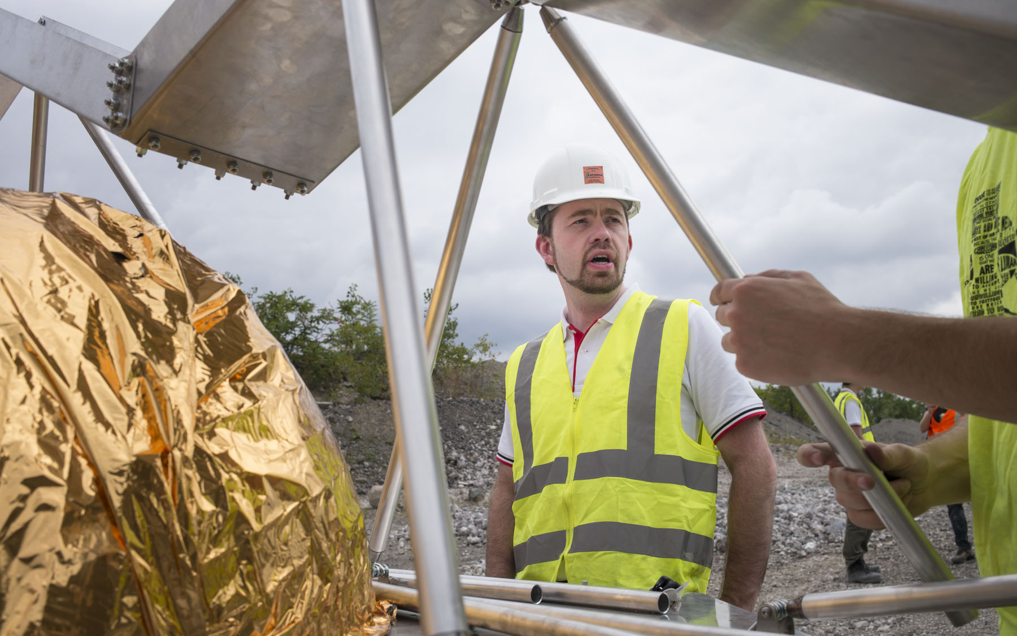
Pittsburgh Field Testing

Slide 49
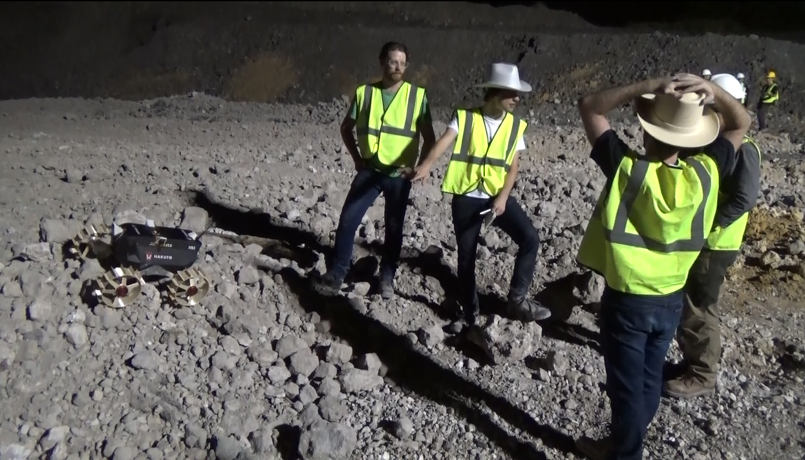
Pittsburgh Field Testing Results
Promising results
All major goals successful
Found many software bugs to fix
“Immersive viewing” very useful
“Connectivity map” excellent for troubleshooting
User attention issues

Slide 50
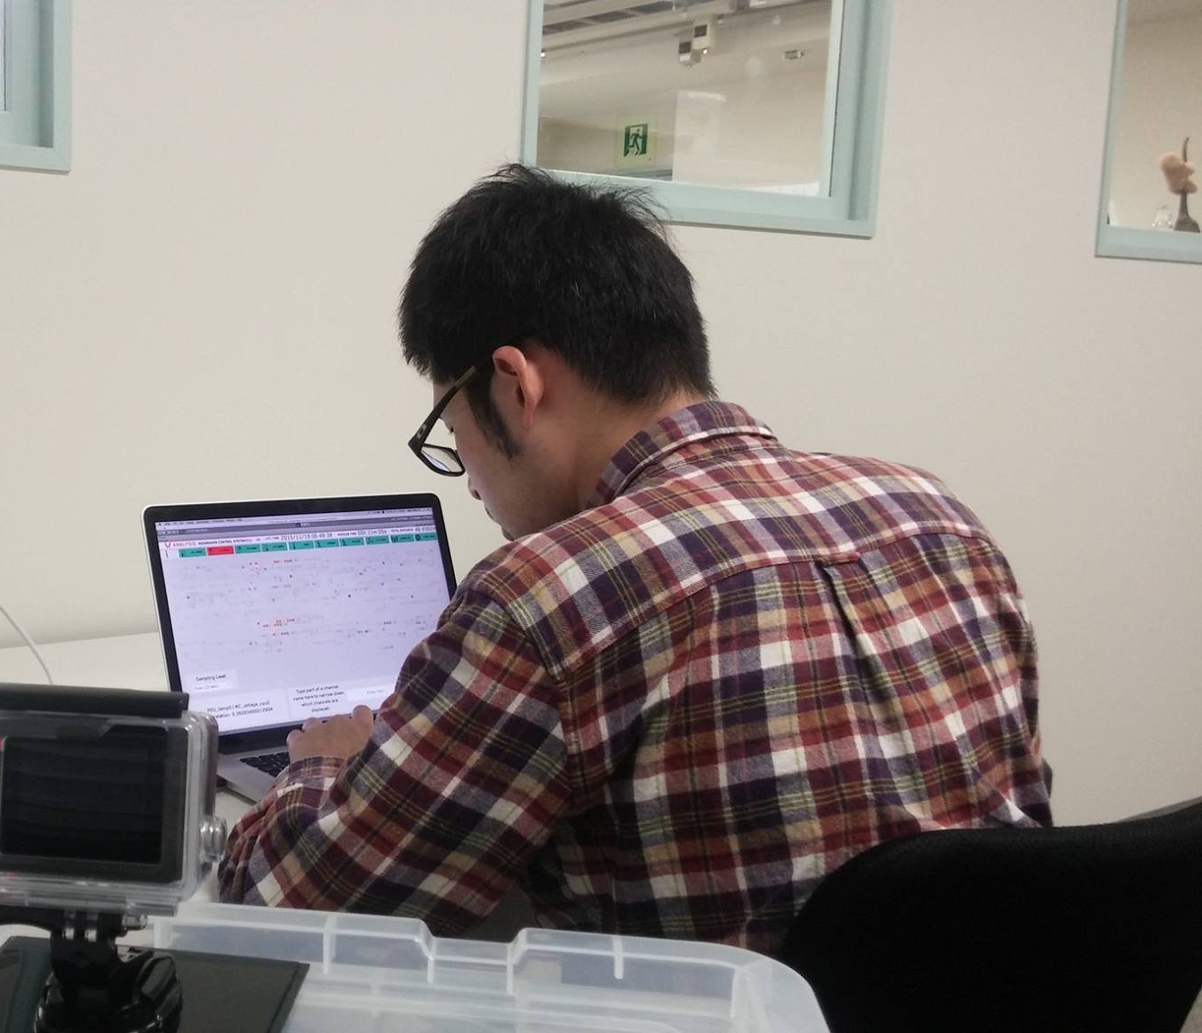
Ground Station Usability Testing Overview
November 2015 testing to find usability issues
Emphasize on data monitoring, analysis
Seven participants
All without extensive GSN experience
10-minute simulated Moonraker lunar run
Each user watched this telemetry and analyzed it
Users told story of what happened

Slide 51
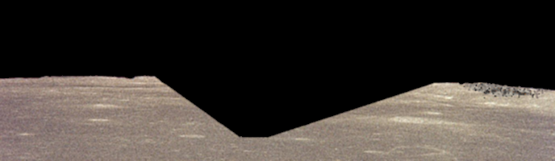
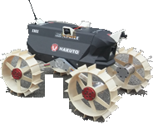
Usability Testing Events
0s: Rover begins traveling forward along smooth terrain.

Slide 52
Usability Testing Events
188s: Rover begins descending into crater.

Slide 53
Usability Testing Events
223s: Rover loses line of sight with lander and packet drops begin.

Slide 54
Usability Testing Events
287s: Rover enters shade, causing temp, comms, and power drops.

Slide 55
Usability Testing Events
300s: Rover begins traversing smooth bottom of crater.

Slide 56
Usability Testing Events
330s: Rover begins climbing out of crater.

Slide 57
Usability Testing Events
343s: Rover exits shade; rover continues uphill.

Slide 58
Usability Testing Events
534s: Rover emerges from crater and enters smooth terrain.

Slide 59
Usability Testing Events
594s: Rover enters choppy terrain.

Slide 60
Usability Testing Events
643s: Rover wheel has fault; rover stops moving.

Slide 61
Usability Testing Results
User intuition matched planned simulation events
Telemetry and fault detection-specific displays very useful
Tunnel vision
More fault descriptions requested
Animated corrgram was hard to use, understand

Slide 62
Testing Takeaways
Ground station extremely useful for standard operations
Needs improvement for root cause analysis to be possible
Need to better capture expert knowledge about faults
Corrgram has too much information to process quickly
Corrgram only shows one point in time at a time
Need to show everything at once

Slide 63
Overview
Motivation and Objectives
Model Definition
Fault Detection Background
Correlative Analysis and Visualization Background
Lunar Rover Ground Station Development
Intermediate Testing
2D Embedding Visualizations
Future Work and Conclusion
Acknowledgements
References

Slide 64
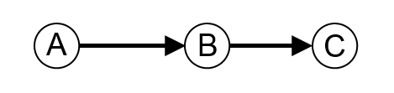
Undirected Correlation Graphs
Start with dependency graph
2D embedding where dependency represented with edge directions
A depends on B; B depends on C:
Variation: undirected graph where edges indicate correlation (each node is a data channel)

Slide 65
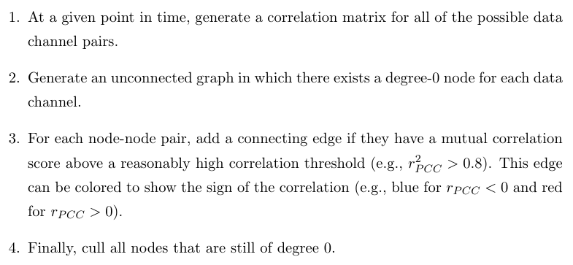
Applying Undirected Correlation Graphs

Slide 66
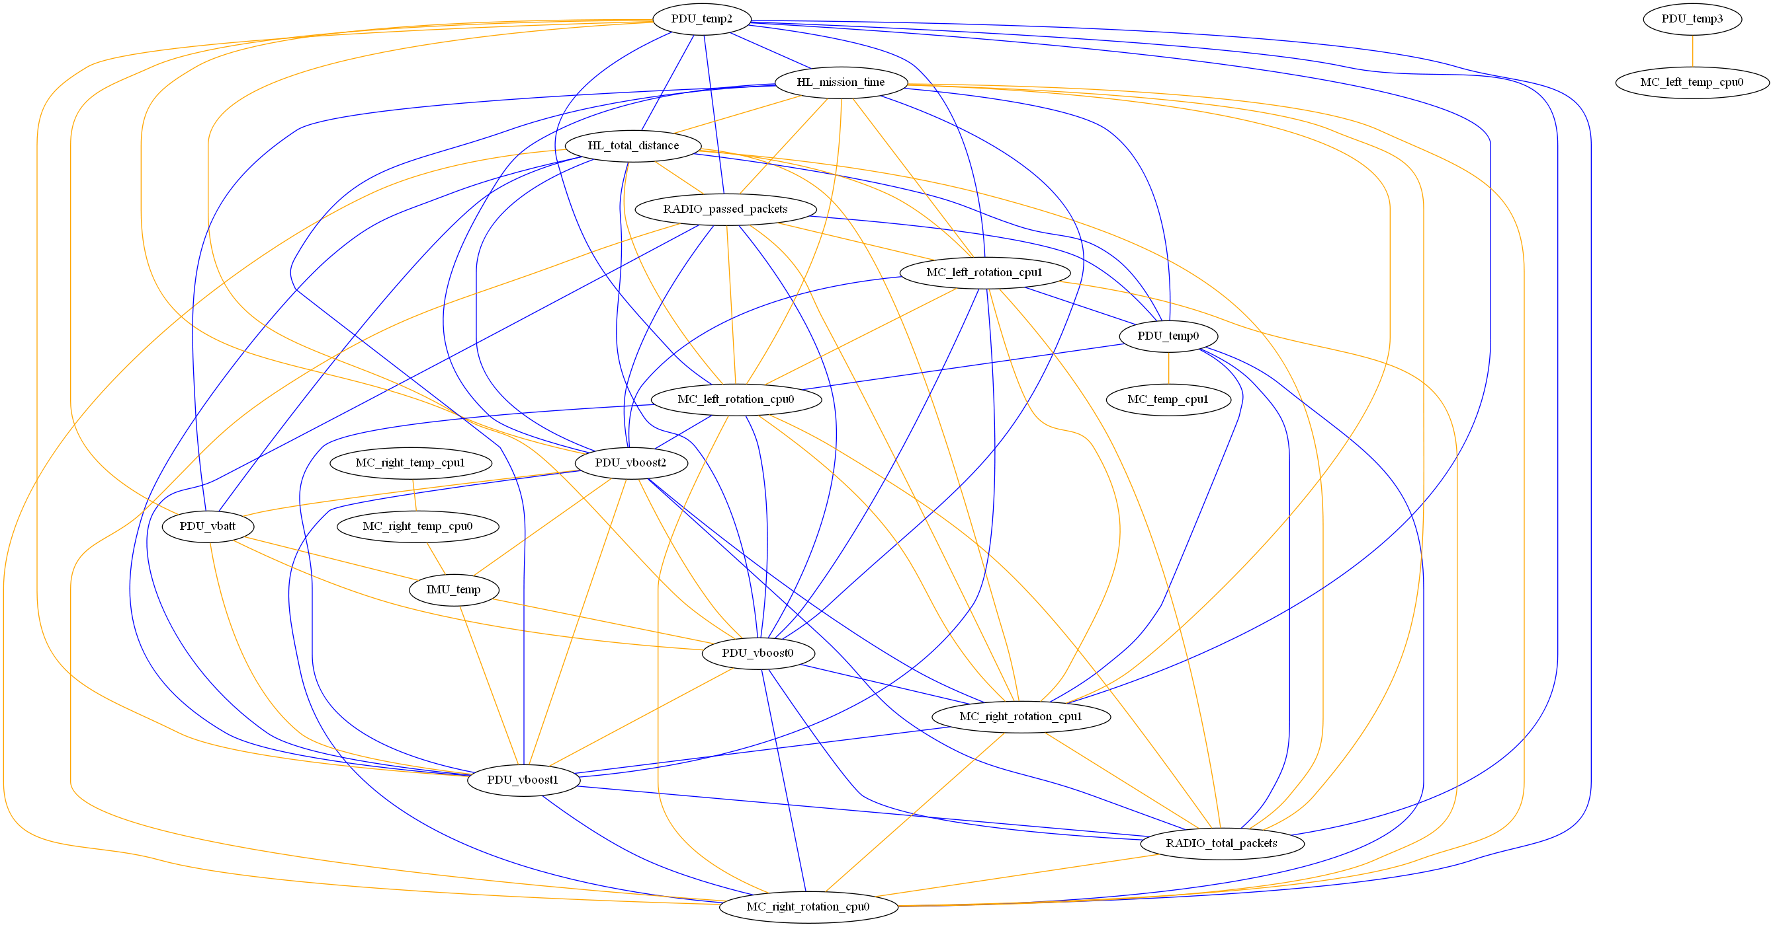
UCGs: Full Correlation

Slide 67
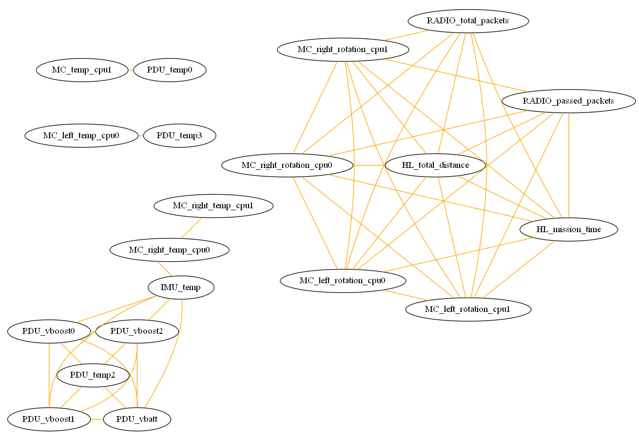
UCGs: Positive Correlations Only

Slide 68
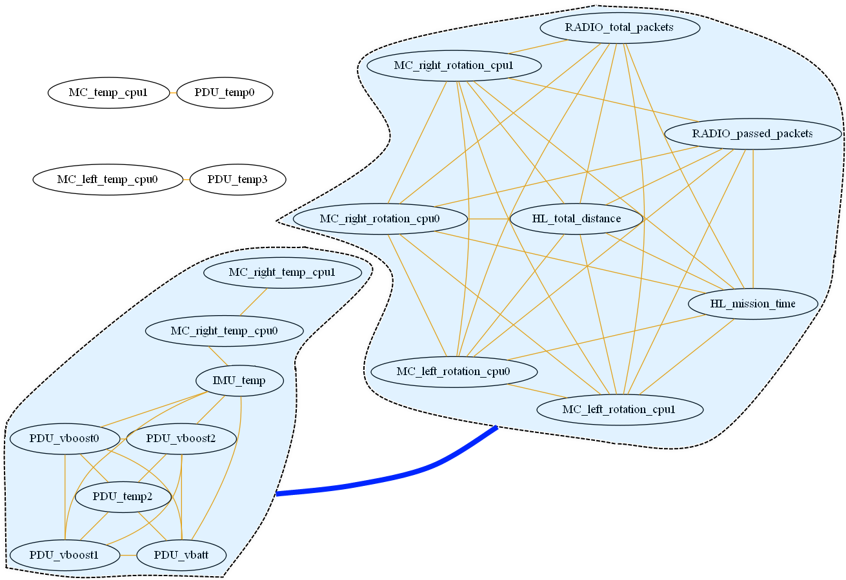
UCGs: Positive Correlations with Cluster Correlations

Slide 69
Observations
Correlations and clusters can be understood at a glance
Positive correlations most intuitive
Low-degree subgraphs worthy of second look
Doesn’t capture correlative state over time (needs to be animated)

Slide 70
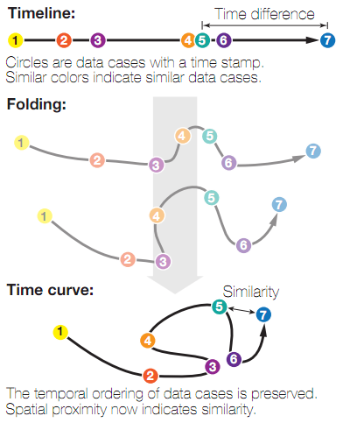
Time Curves
Bach et al. algorithm from 2015
Constructs 2D embedding showing changing system state over time
Uses a set of “time points” and data about their distances to make a graph embedding that shows distance between states while maintaining temporal ordering

Slide 71
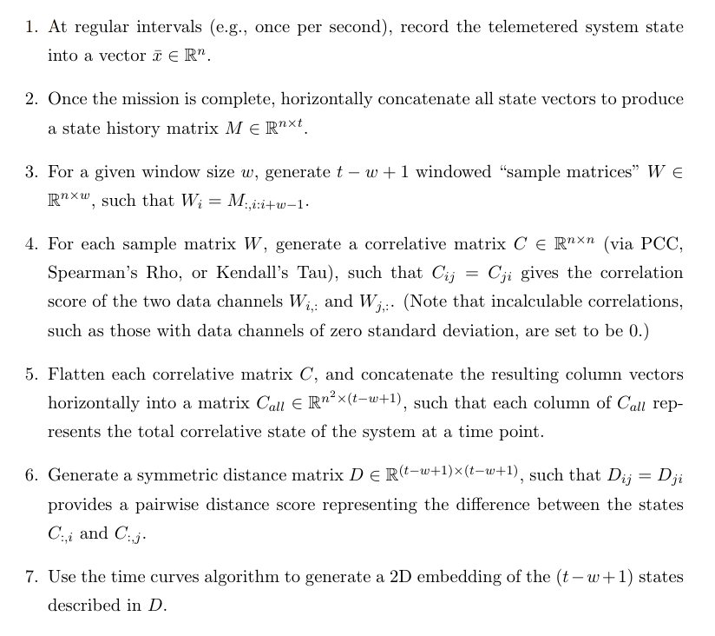
Applying Time Curves

Slide 72
Time Curve Data to Visualize
Used simulated rover data (based closely on real telemetry)
0
1
7
8
9
2
3
6
4
5

Slide 73
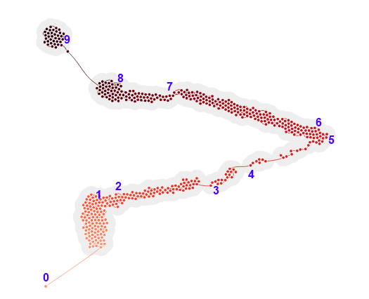
Time Curves on Raw Telemetry State Data

Slide 74
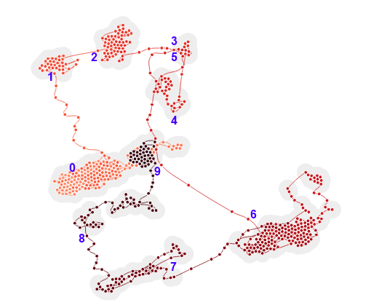
Time Curves on PCC Correlation State

Slide 75
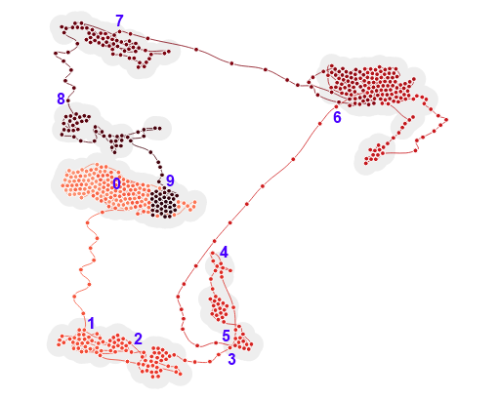
Time Curves on Rho Correlation State

Slide 76
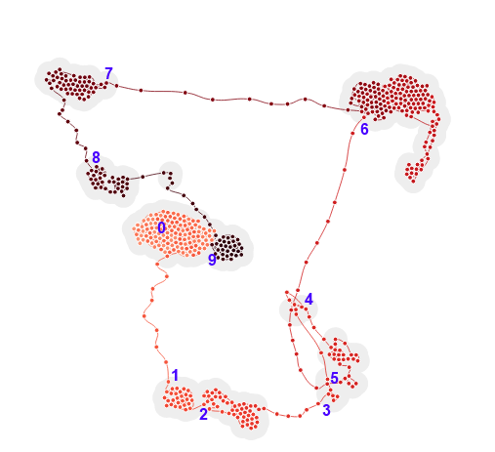
Time Curves on Tau Correlation State

Slide 77
Observations
Viewer can easily follow state progression and see operational modes
Major moves correspond cleanly to actual timestamps
Correlative analysis progression easier to understand
Internal relationships (rather than environmental ones) more easily captured by correlation
Rank correlative measures better than PCC
Able to “discover” unique states that aren’t expected
Very promising and capable of suggesting correlative changes

Slide 78
Overview
Motivation and Objectives
Model Definition
Fault Detection Background
Correlative Analysis and Visualization Background
Lunar Rover Ground Station Development
Intermediate Testing
2D Embedding Visualizations
Future Work and Conclusion
Acknowledgements
References

Slide 79
Further Work
Integrating visualizations into a cohesive flow
Use data channels at portals between visualizations
Make entire visualization flow automated, real-time
Test on more data sets
Currently talking to University of Michigan, University of Tokyo
Re-test usability with new analytical and visualization features

Slide 80
Conclusion
Built ground station for real aerospace system
Incorporated high-level FDIR troubleshooting
V&V’ed in 100+ hours of field testing and usability testing
Built analytical system to find correlative state
Created three new types of correlative visualizations
Showed that these visualizations give insights that hold up to scrutiny
Tools show promise for future troubleshooting

Slide 81
Overview
Motivation and Objectives
Model Definition
Fault Detection Background
Correlative Analysis and Visualization Background
Lunar Rover Ground Station Development
Intermediate Testing
2D Embedding Visualizations
Future Work and Conclusion
Acknowledgements
References

Slide 82








Acknowledgements

Slide 83
Overview
Motivation and Objectives
Model Definition
Fault Detection Background
Correlative Analysis and Visualization Background
Lunar Rover Ground Station Development
Intermediate Testing
2D Embedding Visualizations
Future Work and Conclusion
Acknowledgements
References

Slide 84



References

Slide 85



References

Slide 86


References

Slide 87


References

Slide 88

Thank you!
Questions?

